Slide 1



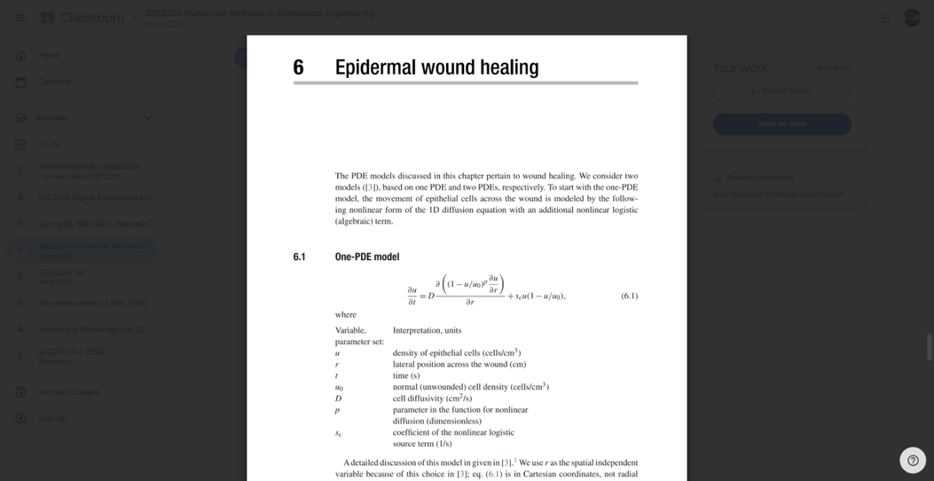
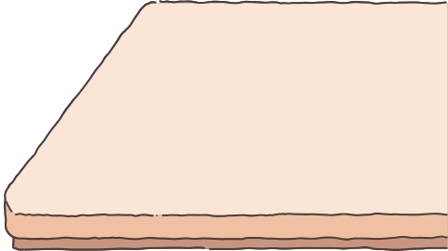

EPIDERMAL WOUND HEALING
Team : SkinDeep Solutions

Slide 2


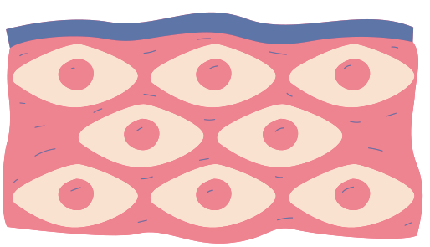
Introduction
Epidermal wound healing is a critical biological process involving the coordinated migration and proliferation of epithelial cells to restore skin integrity after injury
The healing process is modeled by a nonlinear PDE capturing cell diffusion and growth.

Slide 3

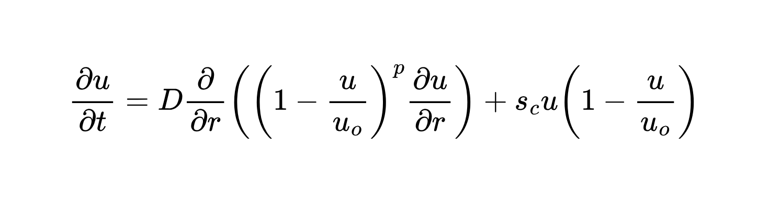





Mathematical model
Nonlinear diffusion term
Logistic growth term
• u(r, t) is the epithelial cell density
• r is the position across the wound
• t is time
• D is the cell diffusivity
• u0 is the normal (unwounded) cell density,
• p controls the nonlinearity of diffusion
• sc is the cell proliferation rate.

Slide 4
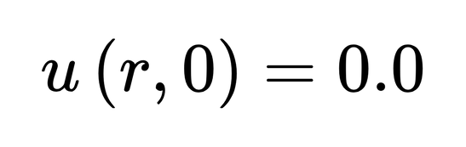
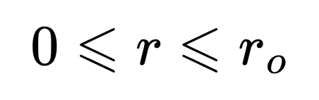
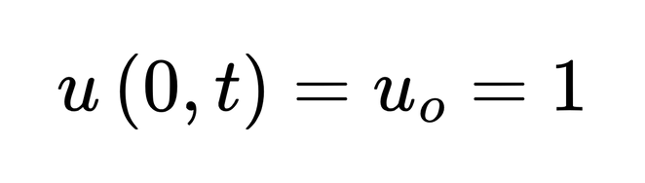
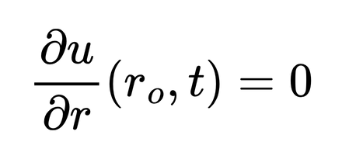
Initial & Boundary conditions
Initial Condition: no epithelial cells are present in the wound
Boundary Conditions: At the wound edge, the cell density is normal. At the center, there is no net cell flow

Slide 5

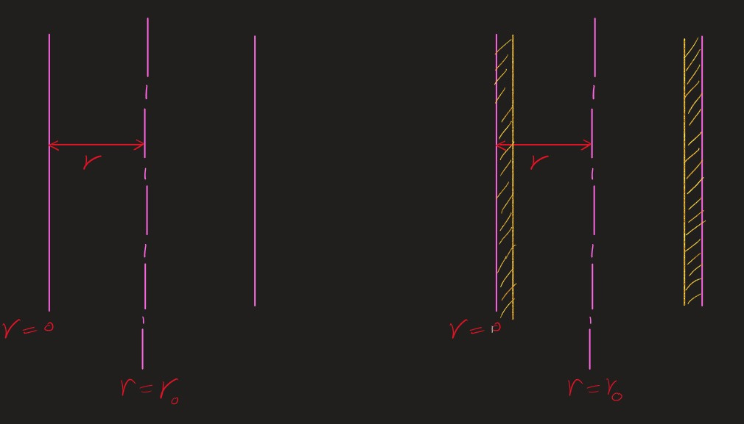

Image for illustration

Slide 6
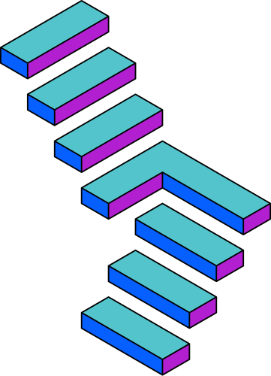

Numerical methods
Method of lines (MOL)
Finite element method (FEM)
Finite difference method (FDM)

Slide 7


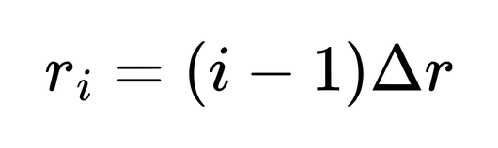
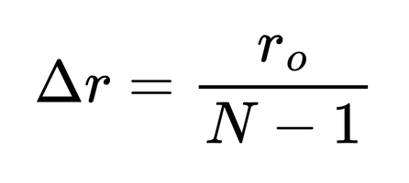
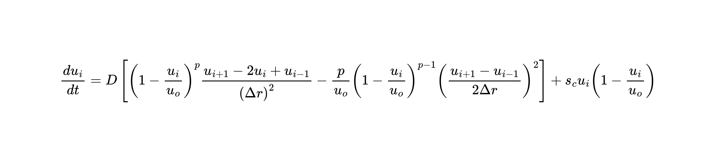

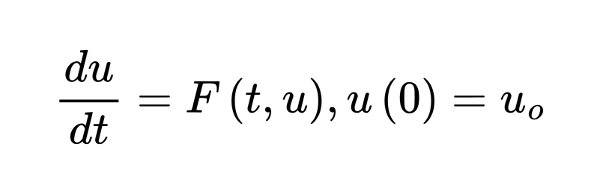
Method of lines
PDE
system of ODEs
grid points
Final equation:
Solve the ODE system:

Slide 8
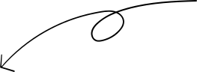
FD Methods
Implicit FD
Crank Nicolson
Explicit FD

Slide 9
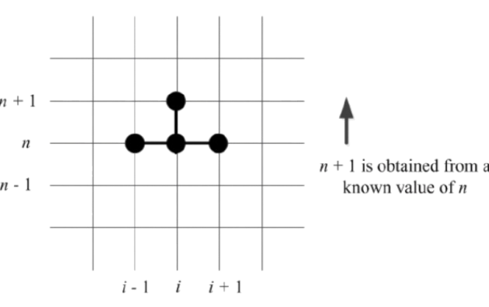
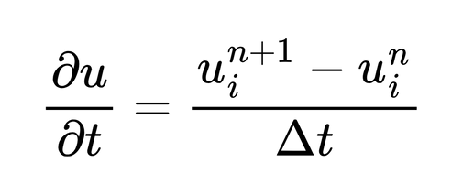
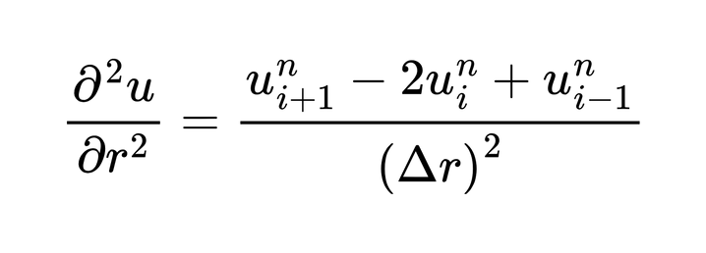
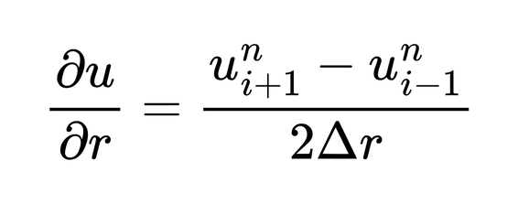

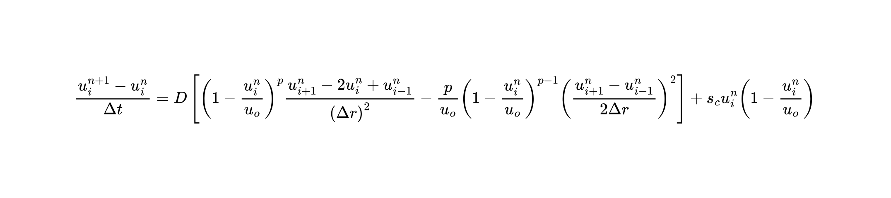
Explicit FD
The expanded PDE is discretized as
Final explicit equation:

Slide 10

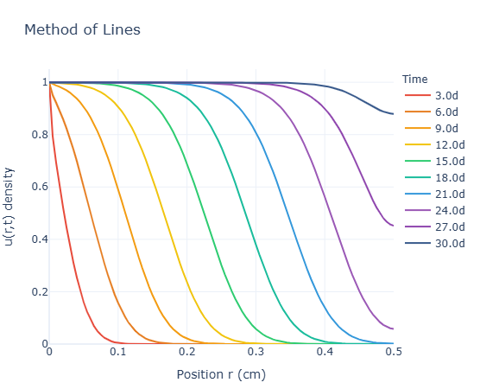
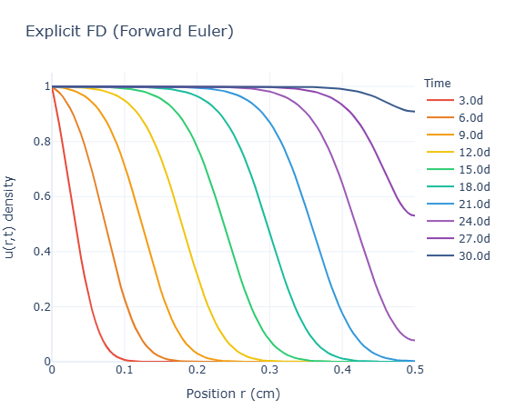
output
r0= 0.5, D= 2.0e-9, sc=8e-6, p= 1, days: 30

Slide 11
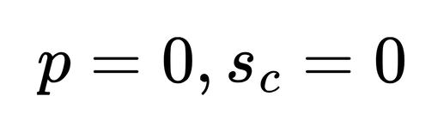
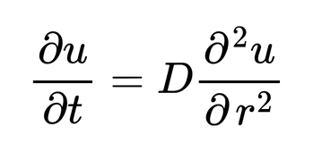
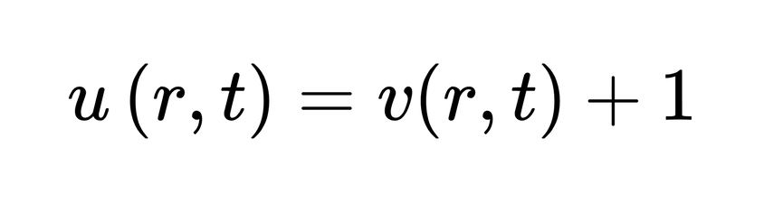
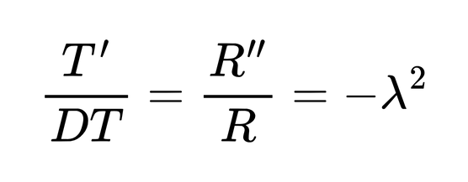
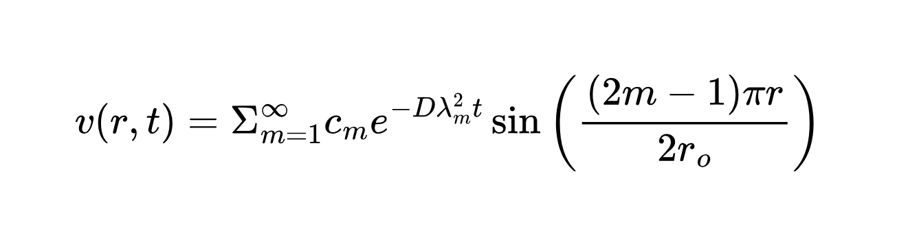
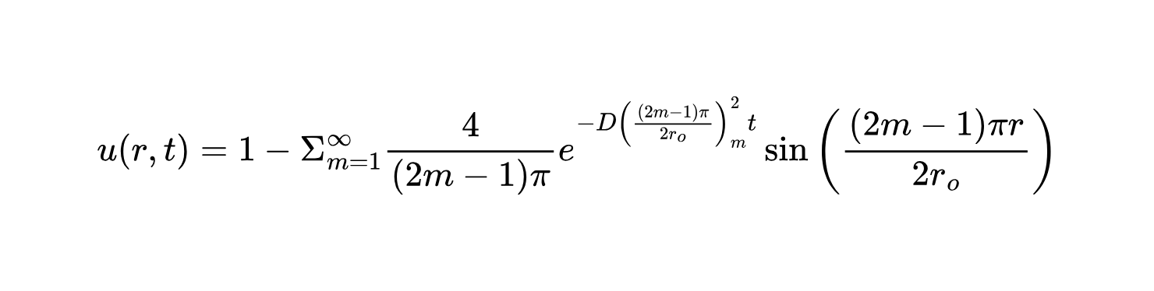
Analytical
PDE simplifies to the heat equation
Using separation of variables
The general solution is
The complete solution is:

Slide 12
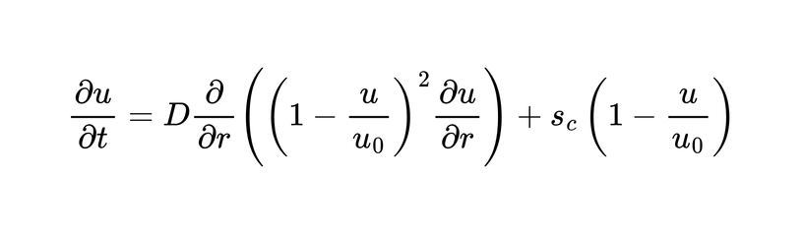
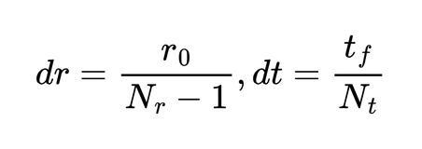
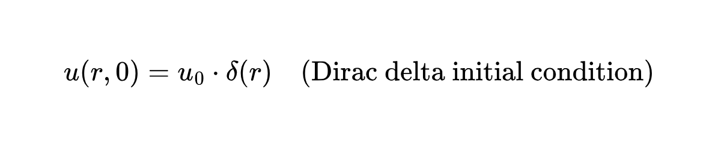
FEM
main equation :
Discretize Space and Time
Initialize Variables
Compute Diffusion Term
Compute Source Term (Logistic Growth)
Time Integration (Forward Euler)

Slide 13
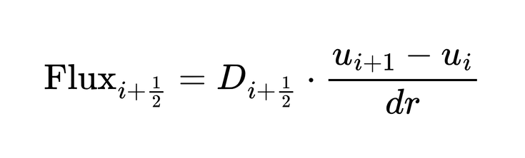
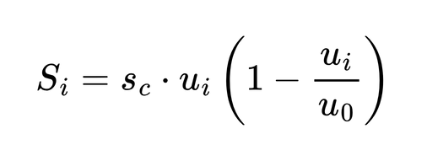
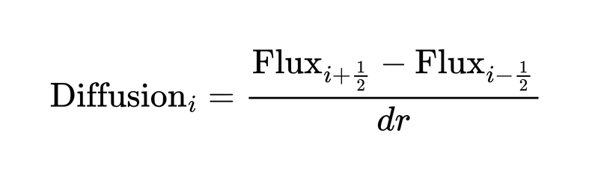
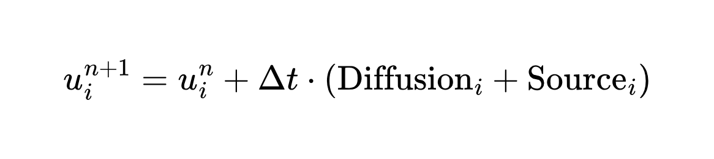
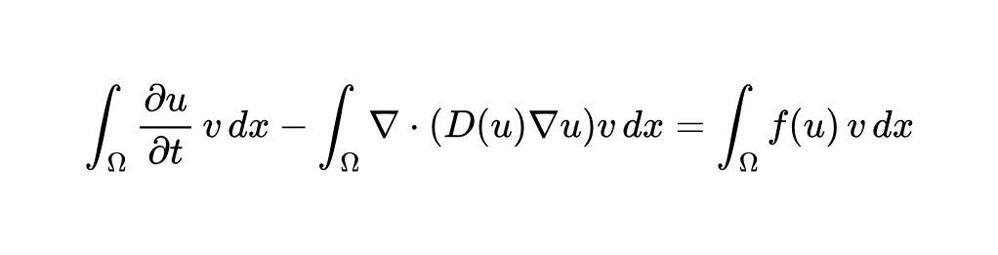
FEM
Compute Diffusion Term
Compute Source Term (Logistic Growth)
Rearrange to Use explicit time-stepping (Forward Euler)system:

Slide 14
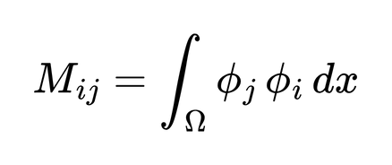
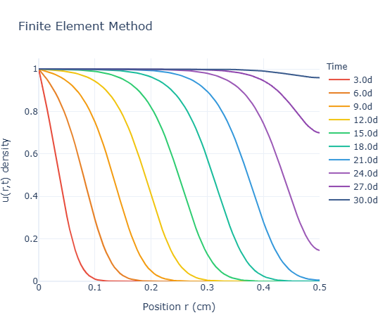
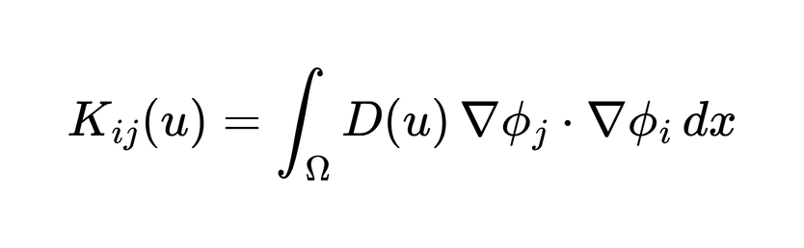
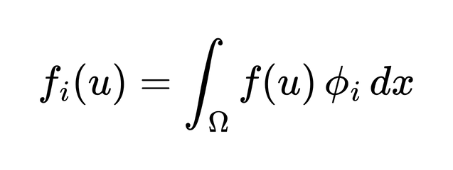
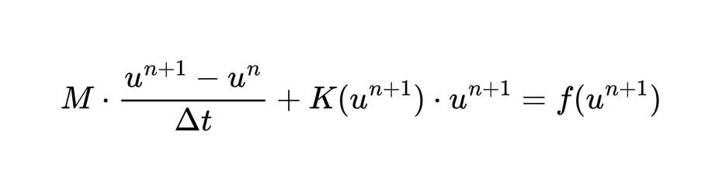
FEM
:Mass Matrix
: Stiffness Matrix (Nonlinear Diffusion)
: Source Vector
r0= 0.5, D= 2.0e-9, sc=8e-6, p= 1, days: 30

Slide 15
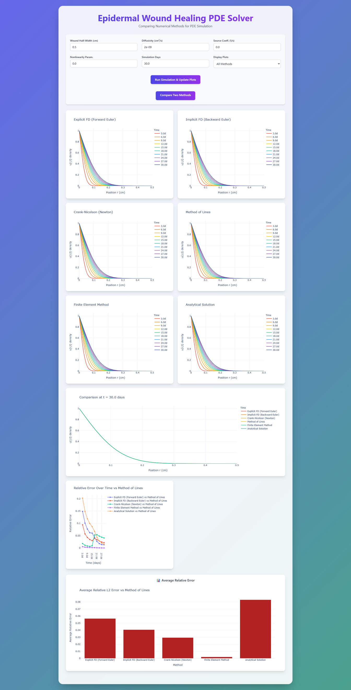

Slide 16
Deep learning methods
Supervised Neural Network
Physics-Informed Neural Network

Slide 17

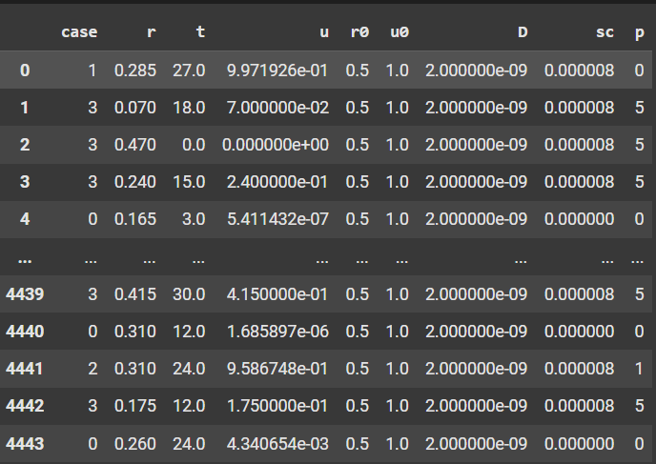
Data Collection
We stored reference solution in a CSV file with:
case number
Spatial position r_cm
Time in days t_days
Parameters D, sc, p, u0, r0
Output variable: u
4444 rows × 9 columns

Slide 18
Preparing Data for Deep Learning
Extracted input features:
Output target:
X = [R, T, D, SC, P]
y = u
Applied MinMaxScaler to normalize inputs and output between [0, 1].
Used train_test_split to split into:
80% training
20% testing

Slide 19

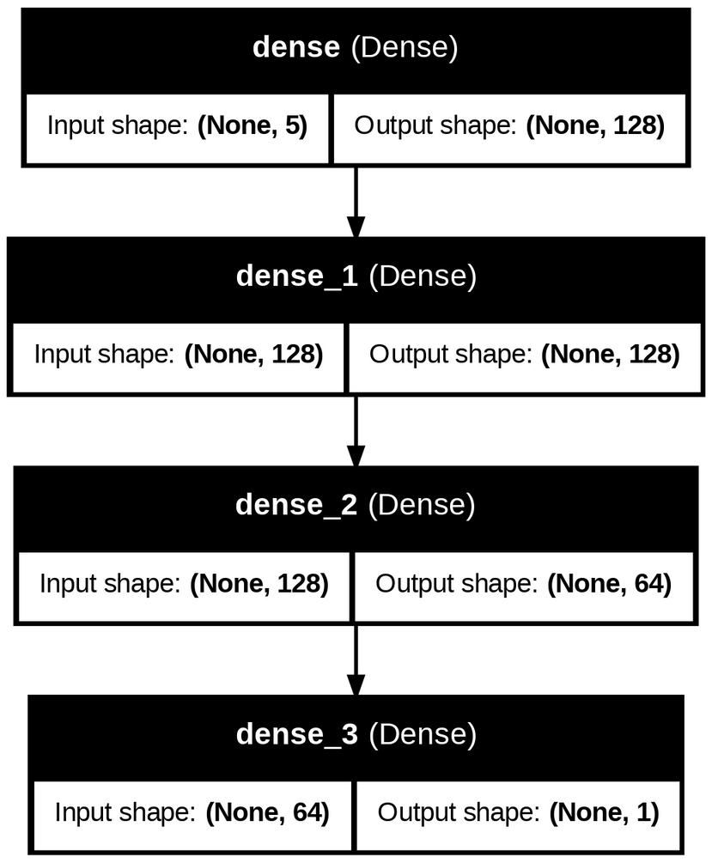
1. Supervised NN Architecture
Model:
3 hidden layers with ReLU activation:
Optimizer: Adam
Loss function: Mean Squared Error (MSE)

Slide 20
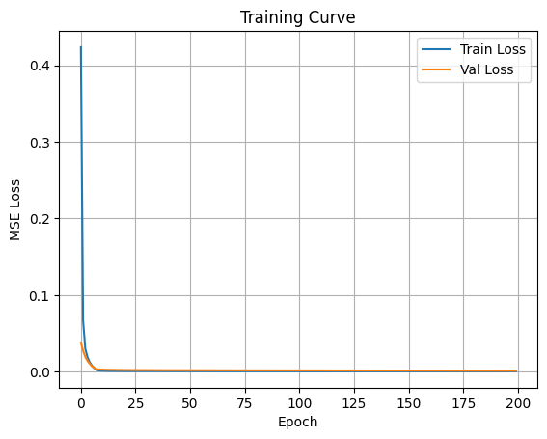

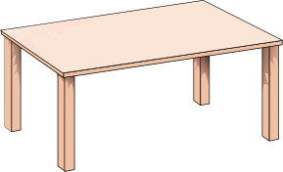
MODEL TRAINING
200 epochs, batch size 256.
Tracked training and validation loss (MSE).
Training Curve:
Shows convergence of the model
Validates that overfitting is avoided
Test MAE: 0.0073

Slide 21
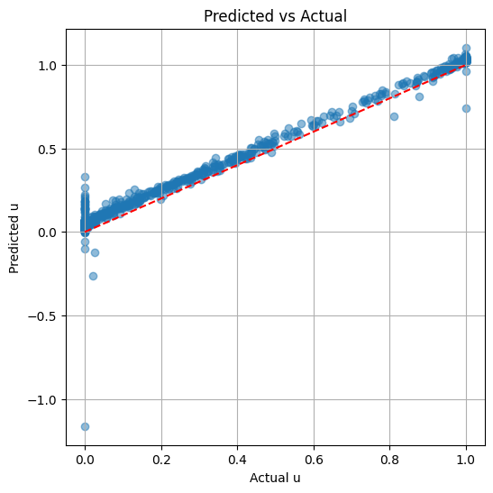
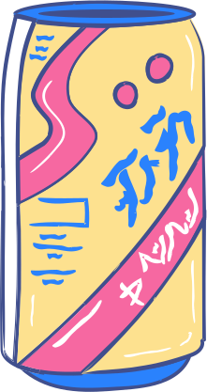

MODEL PREDICTION
Time per DL prediction: 0.4063 ms
Test R²: 0.95

Slide 22
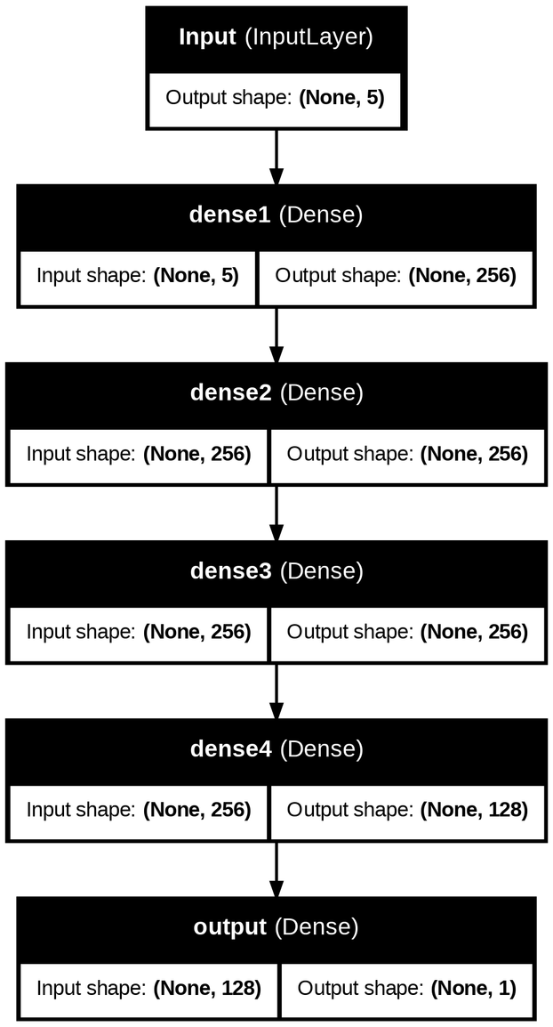
2. PINN Architecture
Model
Layers:
3 hidden layers with 256 units
(ReLU activation + BatchNorm + Dropout)
1 additional hidden layer with 128 units
Output layer
Regularization:
BatchNormalization to stabilize training
Dropout (0.1) to prevent overfitting
Initialization:
Glorot Normal for faster convergence

Slide 23
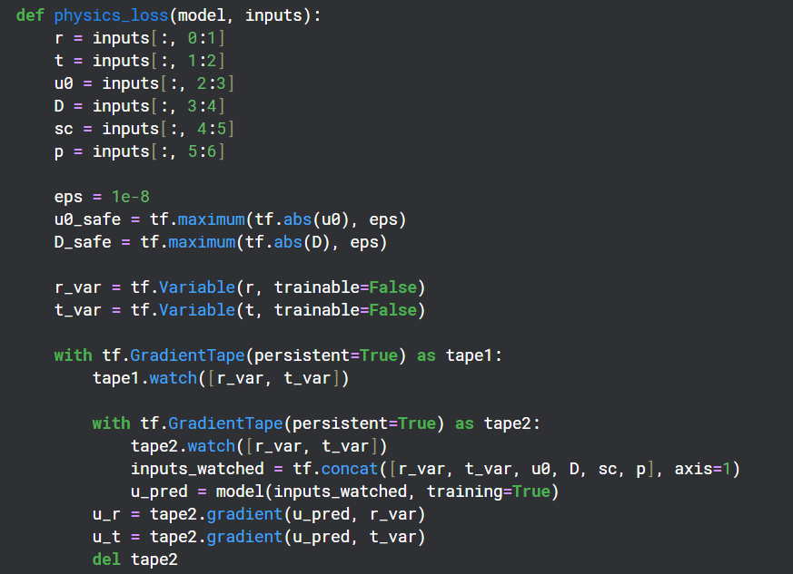

Loss Function

Slide 24



MODEL PREDICTION
Test Results:
Test MSE: 0.000171
Test MAE: 0.008170
Test R²: 0.9314

Slide 25
results & comparison

Slide 26



Linear case
Reference : Analytical Solution
MOL, FEM, and explicit FDM were most accurate.
Implicit FDM had the highest error.
Crank-Nicolson was accurate but slowest.
r0= 0.5, D= 2.0e-9, sc=0, p= 0, days: 30

Slide 27


Nonlinear case
Reference : MOL Solution
Crank-Nicolson achieved the best accuracy, but the slowest one
Implicit FDM had the highest error.
Explicit FDM was fastest.
r0= 0.5, D= 2.0e-9, sc=8e-6, p= 1, days: 30

Slide 28

Summary of Numerical Results
Crank-Nicolson best for precision; explicit FDM for speed.
FEM provided a good balance between time and accuracy

Slide 29

Literature
review

Slide 30

Early models (Linear diffusion)
Sherratt and Murray (1991)
Cell movement is constant everywhere
No effect of crowding
Simpler, but less realistic

Slide 31


Improved models (Nonlinear diffusion)
Cell movement slows down as density increases
Models crowding effect
More realistic model to what actually happens

Slide 32

Future work

Slide 33


Connect to real clinical data
Extend to 2D and 3D wounds (more realistic)
Build a decision-support tool for wound care planning

Slide 34




